Slide 1



light up the web with lit-html 🔥
@mikegeyser
05 October 2019

Slide 2


Sorry!

Slide 3

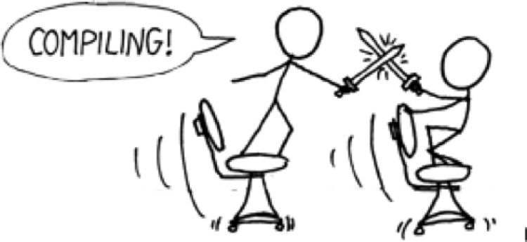

Slide 4


Slide 5
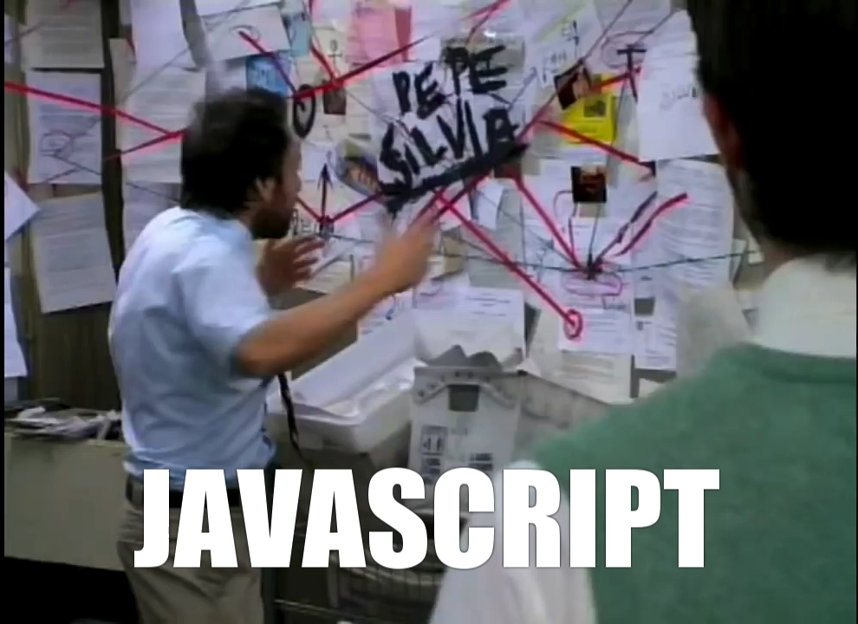

Slide 6




ES5
ES6
ES2015
ES2016
ES2017
ES2018

Slide 7
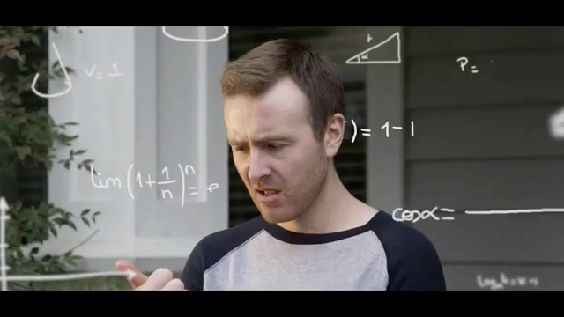

Slide 8
ES2015+
Web Components
+
🔥

Slide 9
what we’ll use
es-dev-server
-> Bare module imports
lit-html
-> Template rendering
LitElement
-> Change detection

Slide 10

JAVASCRIPT

Slide 11
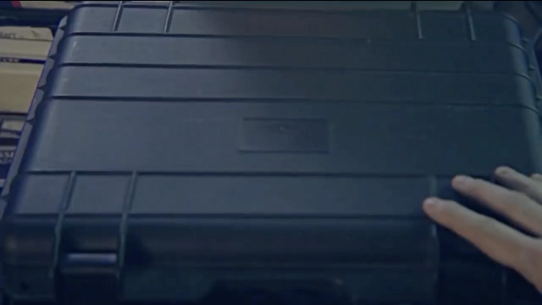
DEMO TIME

Slide 12
in summary
It can (and should) be easier.
It doesn’t *have* to be this (it just works for me).
Keep it simple. Use the platform.

Slide 13
questions?
@mikegeyser
mikerambl.es/videos
lit-html.polymer-project.org

